Slide 1
SAFETY FIRST:
Reducing Traffic Fatalities in Washington
Kelly Jones | May 2018
Notes:
Everybody knows that you should wear your seatbelt. Everybody knows not to drive drunk. Everybody knows to be vigilant when driving near motorcycles or pedestrians. And yet, each year, we lose over 30,000 fellow Americans to traffic accidents, many of which are preventable. My name is Kelly Jones and I am here today to talk with you about the heavy but important topic of traffic fatalities. This presentation may not be especially surprising in its conclusions, but I hope that the truth of it really lands with each of us about the importance of following through on what everybody knows.

Slide 2
“Washington State has adopted Target Zero — a goal to reduce traffic fatalities and serious injuries on Washington's roadways to zero by the year 2030.
“Our goal is zero deaths and serious injuries, because every life counts.”
Notes:
This issue has enormous policy relevance. Here in Washington State, for instance, there is a public safety goal of reaching zero roadway deaths by the year 2030. For this project, I used classification models, machine learning, and data visualization understand whether each individual person involved in a fatal traffic accident was likely to survive or not. We have to understand the problem in order to address it.

Slide 3
Data
Person
Vehicle
Accident
Notes:
My dataset is national data from every motor vehicle accident with a fatality 2015. It is rich and detailed because of the investigation that surrounds a fatal accident. For my analysis, I pulled from three files with three levels of detail, including only drivers and passengers (no pedestrians or bicyclists). At the level of the individual person, we have data on things like their age and whether they were wearing a seatbelt. Each person is nested within a vehicle, for which we have information like its make, model, and year; how many people were inside; and what level of damage it sustained in the crash. Vehicles came together in accidents, so at the accident level, we know what the nature of the accident was, when and where it happened, and what the weather was like that day.

Slide 4
Model: Decision Trees
Boosted with “CatBoost”
1
INPUTS:
67 features
48K observations
OUTPUTS:
Feature Importance
Most Harmful Event
Person’s Age
Vehicle Damage
Restraint Use
TRAIN:
38K
TEST:
10K
Notes:
I will share three parts of my analysis today. The first is the model. After some experimentation, I decided to use decision trees because my data was mostly categorical – even though it started out as numerical codes, which required substantial cleaning and decoding from a 600-page codebook. I had 48,000 complete observations—remember, each one is an actual person—which I split into a train and test set. One output of this model was determining feature importance. Some of the features that emerged were a result of how the data were structured, but some of the others were more relevant. The four listed here were the top features that might have some policy relevance in making changes to impact traffic fatalities in Washington.

Slide 5
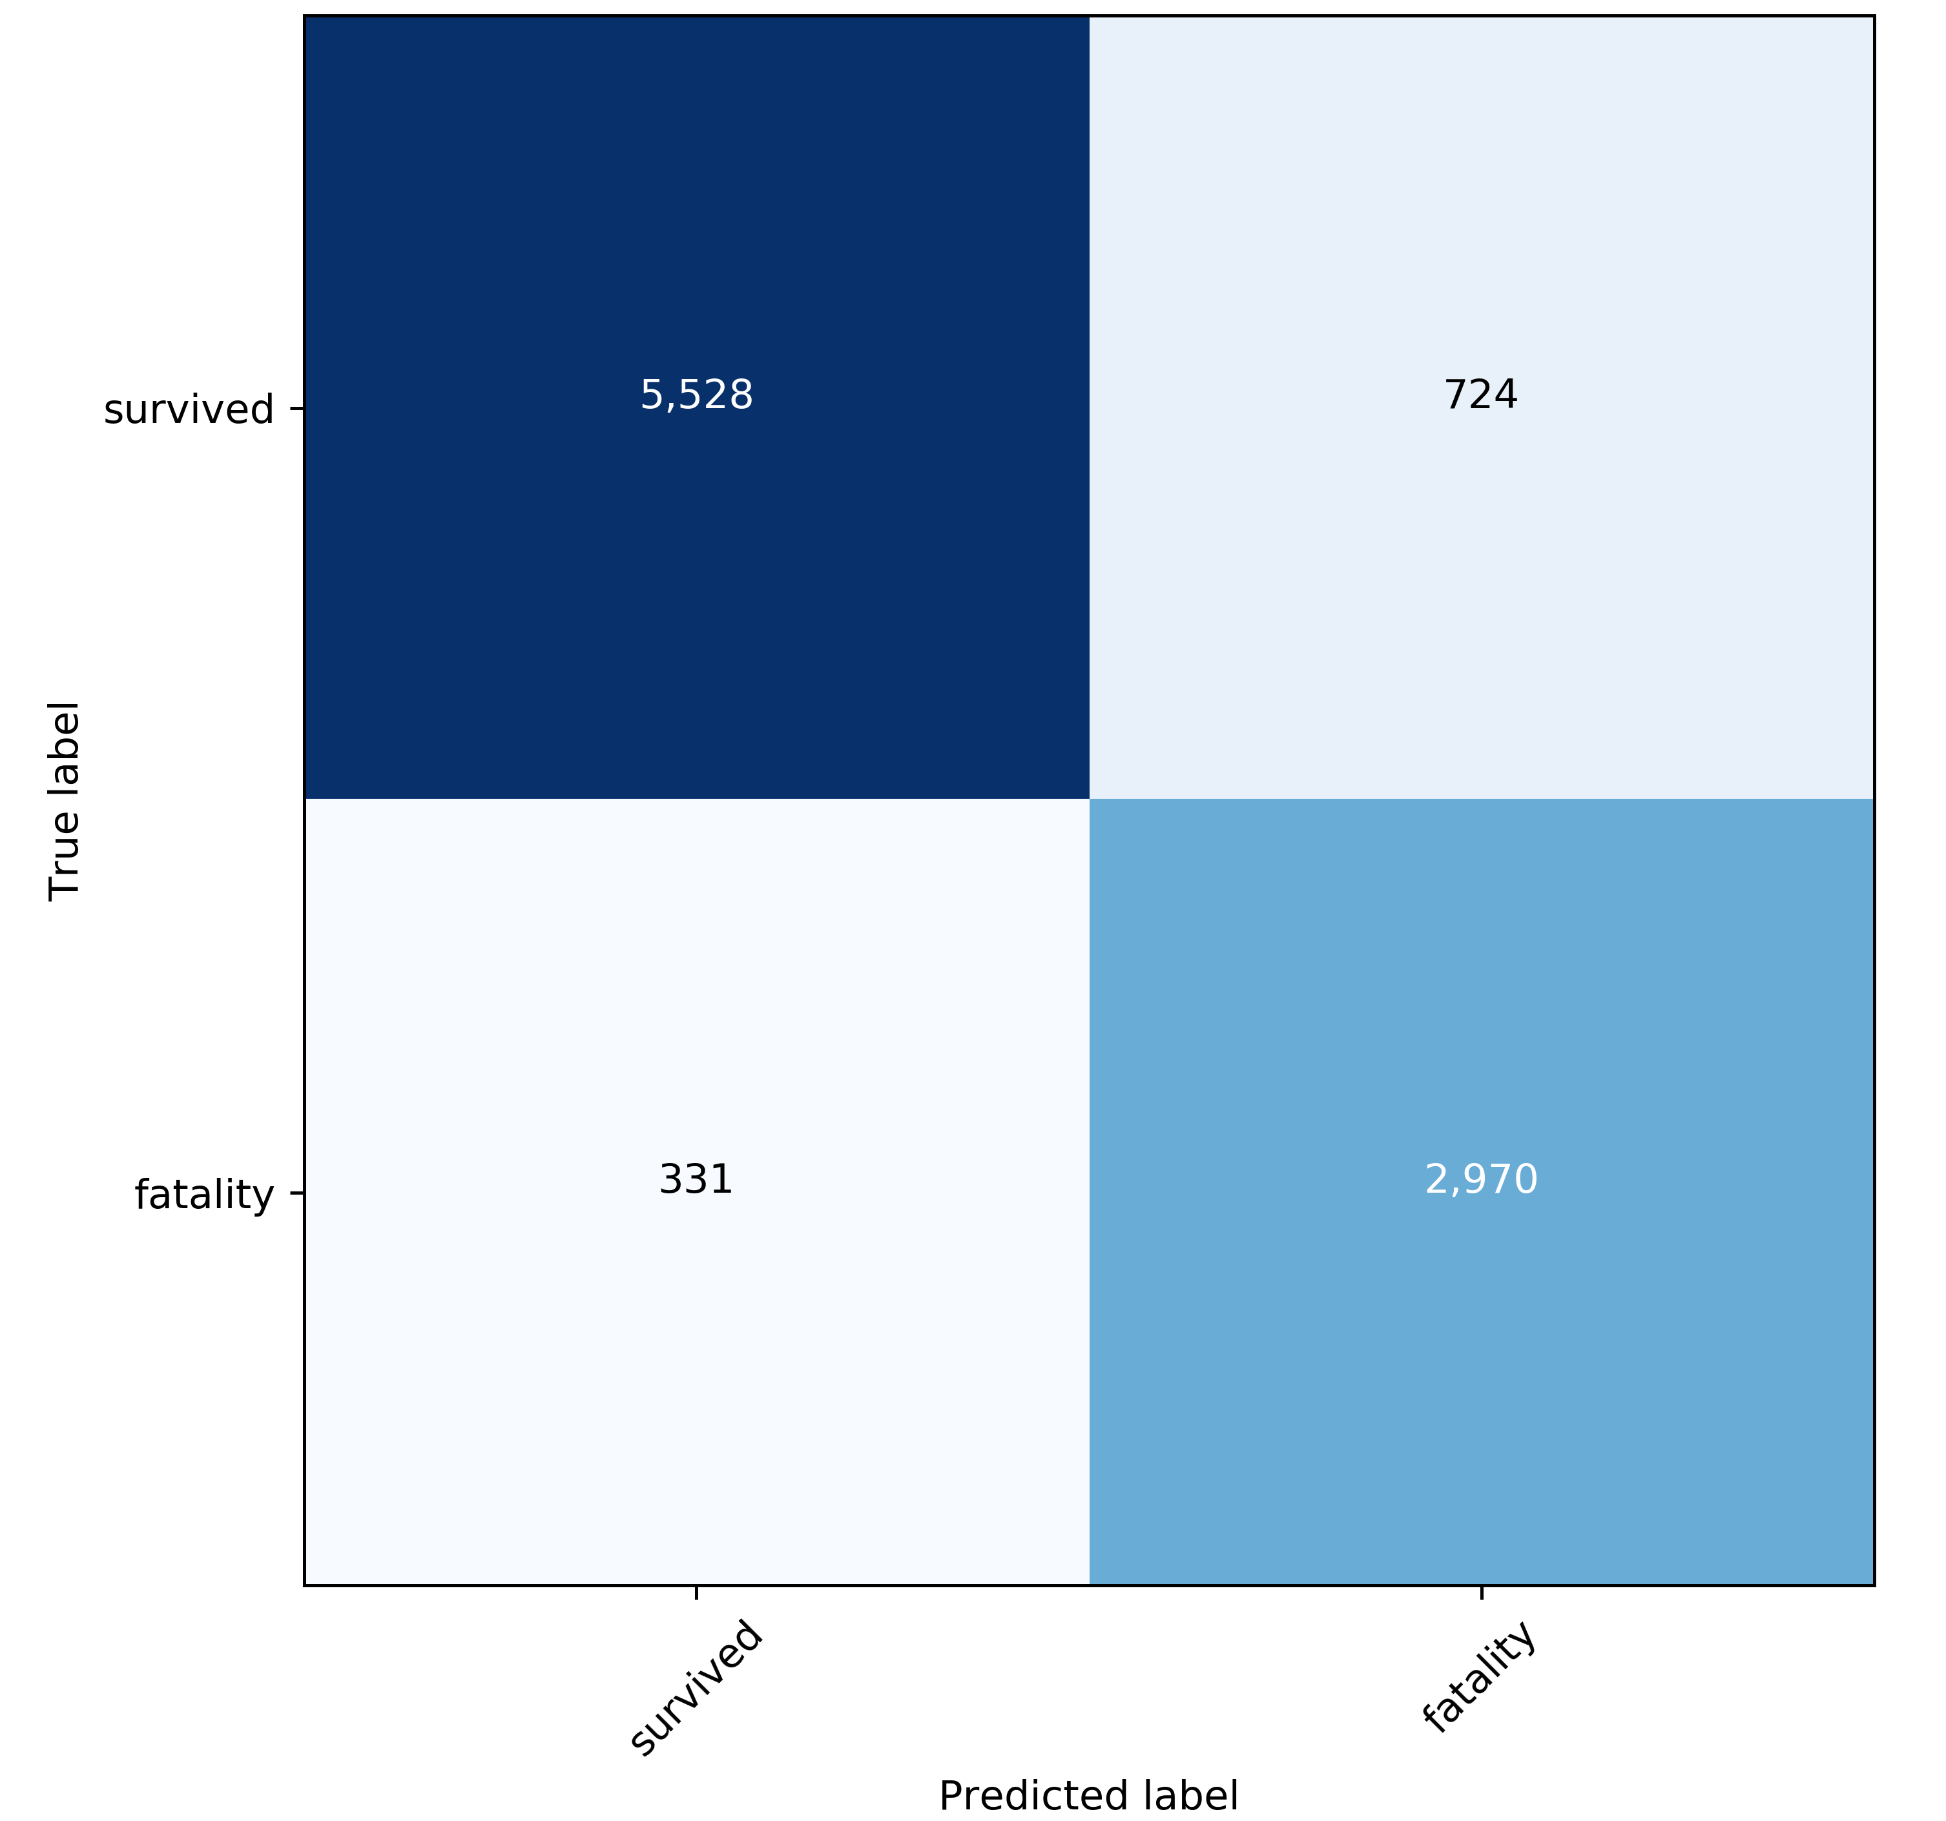
89%
80%
90%
MORE OUTPUTS:
Confusion Matrix
Accuracy How often we were right
5,528
724
Precision Avoiding false positives
331
2,970
Recall Detecting true positives
Notes:
Here are a few more model outputs. This confusion matrix shows how the model performed on the test set. You can see that it correctly classified 5500 who survived and 3,000 fatalities (our positive condition). That’s an 89% accuracy rate. The precision was lower at 80% because we had a number of false positives, but the recall rate is probably most important – we don’t want to miss warning signs of fatalities. We want to minimize the 331 box (those who were predicted to survive but actually suffered fatal injuries). Those are cases our model can’t explain – for example, they were young, healthy, driving in a safe new car, their airbag went off, they were wearing a seatbelt, nobody was drunk, the weather was good… and yet, they still died. We want to understand what happened in those cases so we can help prevent them. (As a corollary: we are not too worried about false positives. How much does it harm a person to wear a seatbelt or to refrain from driving drunk?)

Slide 6
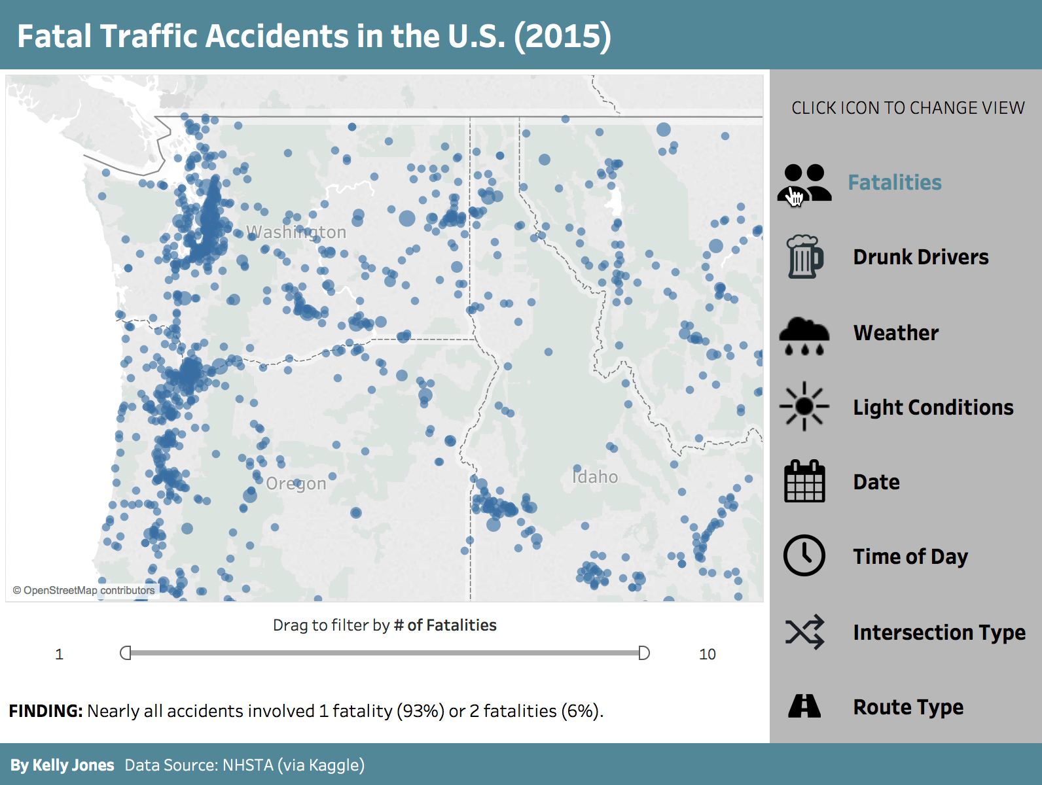
2.
Tableau Dashboards
Explore accident data nationwide across a range of categories
Notes:
[TIME CHECK 3:00] Part 2 of this analysis is a Tableau dashboard to help visualize the data. [start video] As the demo plays, it shows what happens when you click the different icons along the right side of the page to change the view. We start with fatalities: each dot is an accident, with the size representing how many fatalities there were. You can hover to see details of the accident or drag the scale at the bottom to adjust which accidents show up. On the next tab, Drunk Drivers, the red X’s show accidents where at least one driver was drunk. To me, this was a startlingly high rate. State by state comparisons are worth further investigation: in Maine, half of fatal accidents involved alcohol, while in Utah only 17% did. The next tab, Weather, shows the weather at the time of the accident. 70% of accidents happened during clear weather (yellow dots), and the toggle at the bottom lets you select other weather conditions like “Cloudy” or “Rain.” On the Time of Day dashboard, you can see that while the number of accidents peaks in the late afternoon and evening, the % of accidents with drunk drivers peaks in the late night and very early morning hours. The filters at the bottom allow you to select a state and a day of the week. Finally, the Route Type dashboard shows where accidents happened depending on the type of road. Toggle to ”Interstate” (yellow) and you’ll see a clear pattern of where interstate highways exist. To explore this dashboard in more detail, visit https://public.tableau.com/profile/kelly.jones4370#!/vizhome/TrafficFatalities2015/Fatalities

Slide 7
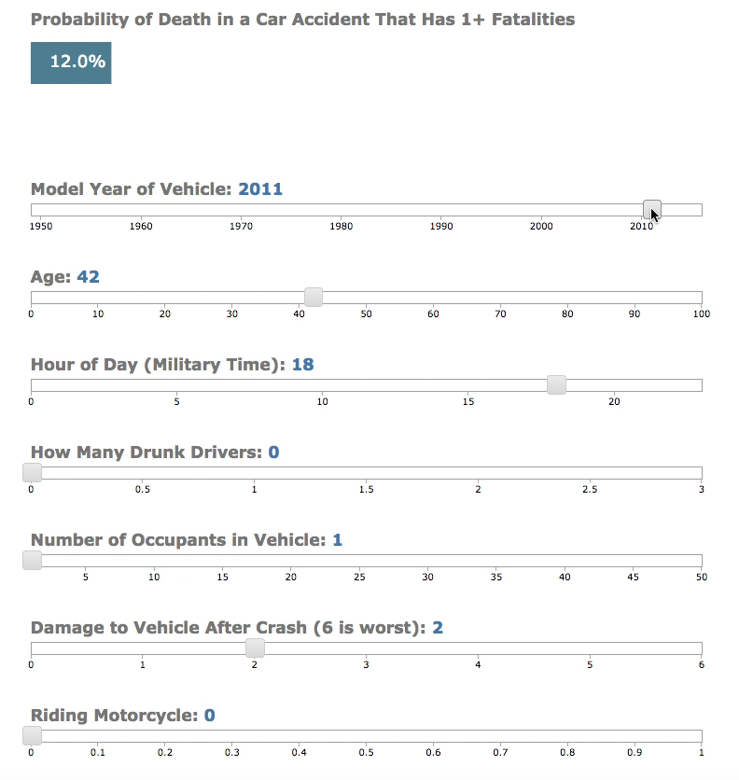
3.
Flask App
Move sliders to get probability estimate of fatality
Model: Logistic Regression
Notes:
[TIME CHECK 4:00] The third and final component of my analysis is a prediction wizard where users input the data. The dataset feeds a Flask app which is based on a logistic regression model and shows how the probability of fatality changes as you move the sliders. You can see that probability increase with older cars, as the person’s age increases, by how many drunk drivers there were, the level of damage to the vehicle, being on a motorcycle, and so on. The Flask app runs on a local machine and is available in my GitHub repository.

Slide 8
Next Steps
◆ Improve Recall ◆ Adjust model (e.g., thresholds) to reduce false negatives
◆ Decode Sequence of Events ◆ Update dashboards with details of how accident unfolded
◆ Analysis by State ◆ Normalized to population (for comparability)
Notes:
[TIME CHECK 4:30] There are several ways I would like to build on these findings in the future. First, I would like to tweak the model to improve its recall rate, such as by adjusting thresholds or adding features. Second, I would like to use the “cevent.csv” (chronological event) data file to parse the individual events for each vehicle in each accident and create a chronology of how the accident unfolded. This would add a layer of interpretability to the data points on the Tableau dashboards. Finally, I would like to dig into differences in fatalities by state—normalized to that state’s population—and start making comparisons across different states which could be used to inform policy decisions at home in Washington State.

Slide 9

THANK YOU!
Data Source | Target Zero (WA) | Project Files | Tableau Dashboards
Notes:
[TIME CHECK 4:50] My hope is that by better understanding traffic fatalities, we will be able to prevent many, many more of them. Thank you.

